Slide 1
Enterprise Architecture
Vision for Building an
EA Framework

Slide 2
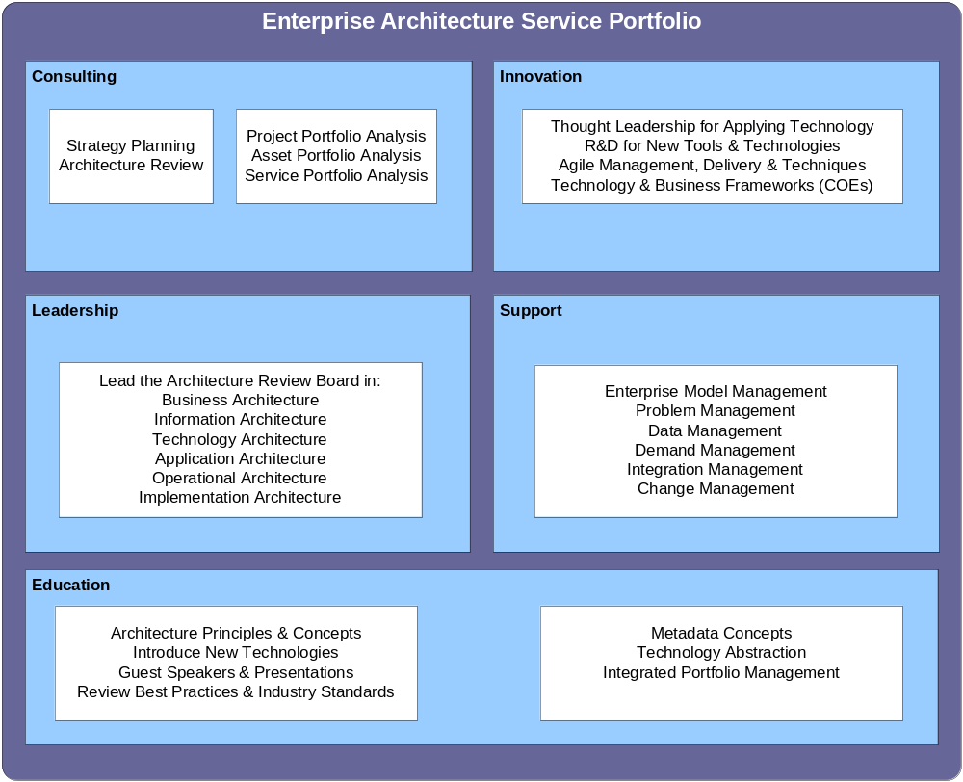
EA Service Portfolio

Slide 3
Overview of EA Scope & Principles
The scope for Enterprise Architecture includes the 6 pillars of Architecture leadership that provides clear boundaries for the key domains within architecture.
The architecture principles are used to provide guidance for IT within each architecture domain as well as general principles that align with business drivers. Principles are used to expedite decision making involving assets used to support the lifecycle for information and technology.

Slide 4
The 6 Architecture Domains
Business Architecture
Information Architecture
Operational Architecture
Technology Architecture
Implementation Architecture
Application Architecture

Slide 5
The 6 EA Domains Explained
Architecture Domain | Scope
Business Architecture | Business Models, Taxonomies, Process Flows, Business Rules & Constraints
Information Architecture | Data Models, Transactional Data, Meta Data, Objects
Application Architecture | Workflow (Business Processes) Service Framework (Business Services)
Technical Architecture | Infrastructure (Platforms = Hardware/OS, Network, Devices = Desktop/Devices) Service Framework (Foundation Services used by App. Dev) Presentation Layer (Portal, Mobile, Fat Client)
Operational Architecture | Metrics Collection, Reporting, Meta Data Mgmt, SLA Mgmt, Dashboards
Implementation Architecture | Change Management Tools (Requirements, Resources, Code, Projects, Collaboration) Testing & Defect Mgmt Tools

